Slide 2
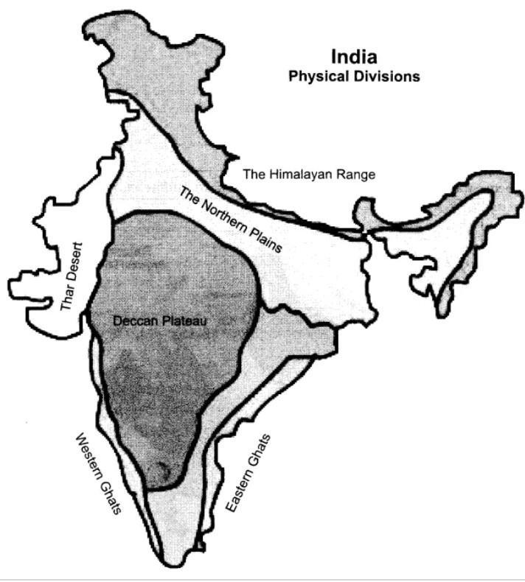
CONTENTS: 1.THE NORTHERN PLAINS The Satluj river basin The Ganga river basin and The Brahmaputra river basin 2.Life in the region 3.THE COASTAL PLAINS Western Coastal plain Eastern Coastal plain
3.THE NORTHERN AND COASTAL PLAINS

Slide 3
PLAINS – A FLAT AND LEVEL LAND. THE NORTHERN PLAINS LIES TOWARDS THE SOUTH OF THE HIMALAYAS. STRETCH FROM PUNJAB TO ASSAM. THE FINE SILT DEPOSITED BY THE RIVERS IS CALLED ALLUVIUM.
THE NORTHERN PLAINS

Slide 4
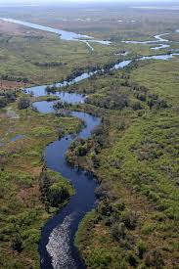
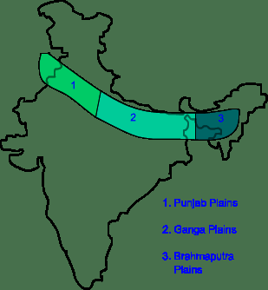
THREE RIVERS
BASIN –THE AREA WATERED BY A RIVER AND ITS TRIBUTARIES .
THREE RIVERS
1.THE SATLUJ RIVER BASIN
2.THE GANGA RIVER BASIN AND
3.THE BRAHMAPUTRA RIVER BASIN

Slide 5
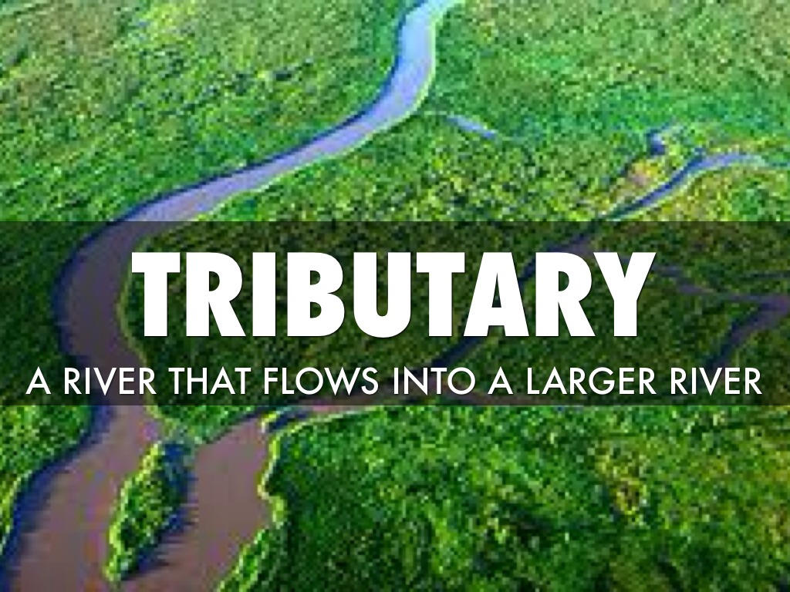
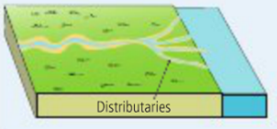
Chapter 3/social/karunambigai/Sns Academy
TRIBUTARY AND DISTRIBUTARY

Slide 6
ORIGINATES IN TIBET BEAS IS MAIN TRIBUTARY PUNJAB AND HARYANA – SATLUJ RIVER BASIN THE BHAKRA DAM - BUILT ACROSS SATLUJ GENERATES ELECTRICITY AND PROVIDES WATER FOR IRRIGATION.
THE SATLUJ BASIN

Slide 7
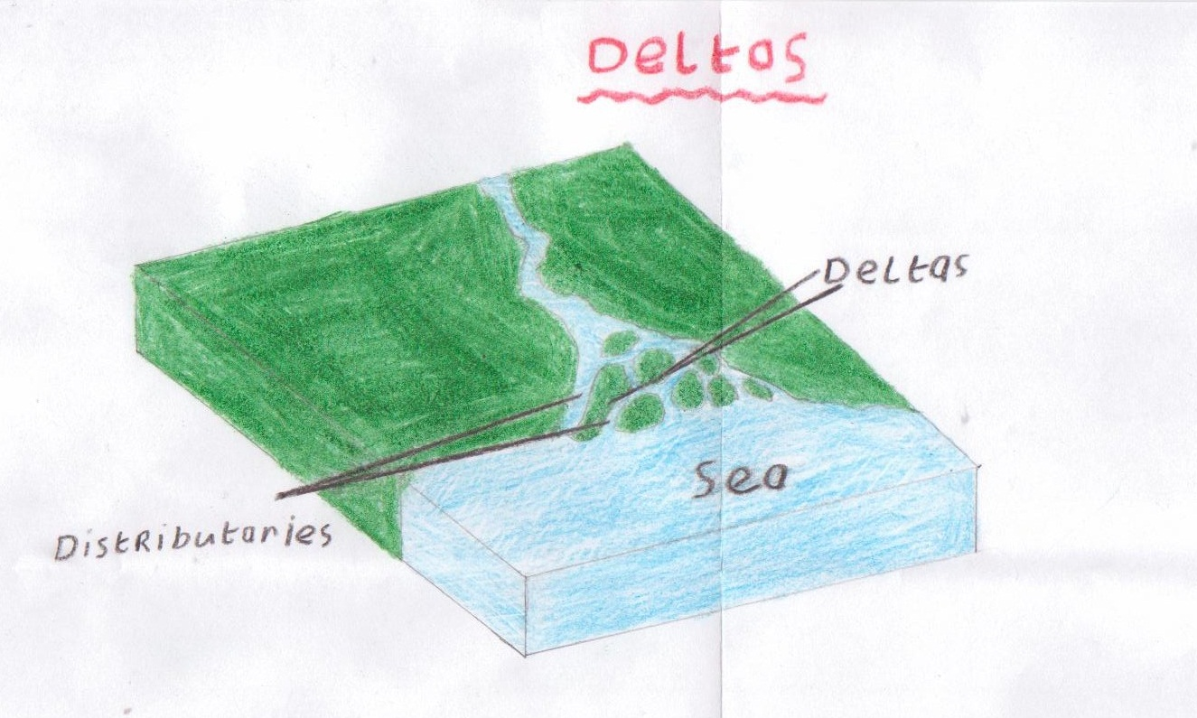
.
A DELTA IS A TRIANGULAR-SHAPED LAND FORMED BY A RIVER BEFORE IT FLOWS INTO THE SEA.

Slide 8
RIVER GANGA- ORIGINATES FROM GANGOTRI GLACIER IN THE HIMALAYAS. YAMUNA – MAIN TRIBUTARY. GANGA AND ITS TRIBUTARIES FLOW THROUGH UTTARKHAND, UTTARPRADESH,BIHAR AND WEST BENGAL. RIVER SPLITS INTO TWO BRANCHES. PADMA AND HUGLI.
THE GANGA RIVER BASIN

Slide 9
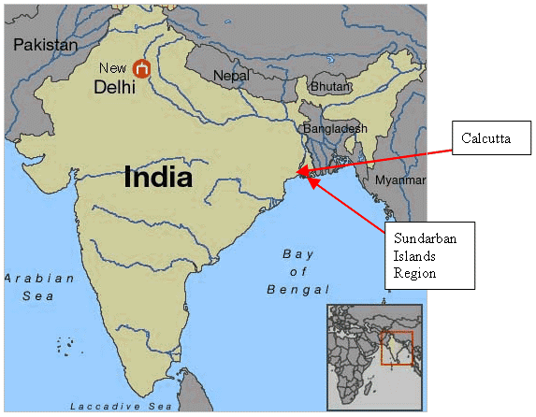
RIVER BRAHMAPUTRA ORIGINATES IN TIBET.(TSANPO) LARGEST DELTA IN THE WORLD. IT IS ALSO CALLED SUNDERBAN DELTA
THE BRAHMAPUTRA RIVER BASIN

Slide 10
Life in the region-MAIN OCCUPATION- FARMING
STATES | FOOD | FESTIVALS | DANCE | TOURIST PLACES
PUNJAB | MAKKE KI ROTI.SARSON KA SAAG AND LOHRI | BAISAKI AND LOHRI | BHANGRA AND GIDDA | GOLDEN TEMPLE IN AMRITSAR
HARYANA |  |  |  | FARIDABAD AND GURGAON ARE INDUSTRIES
DELHI |  |  |  | LOTUS TEMPLE,JAMA MASJID
UTTAR PRADESH |  |  |  | VARANASI AND LUCKNOW
BIHAR | LITTI-CHOKHA AND SATTU PARANTHA | CHHATH |  | PATNA,GAYAAND RAJGIR
WEST BENGAL |  | DURGA PUJA
ASSAM |  | BIHU

Slide 11
THE COASTAL PLAINS

Slide 12
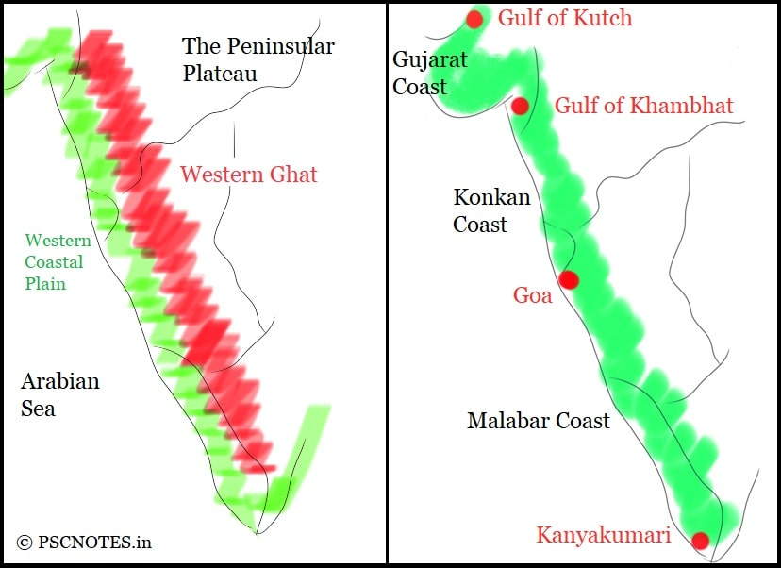
LIES BETWEEEN WESTERN GHATS AND THE ARABIAN SEA. STRETCHES FROM GUJARAT TO KERALA. THREE PARTS 1. THE GUJARAT COAST 2.THE KONKAN COAST AND 3. THE MALBAR COAST.
WESTERN COASTAL PLAIN

Slide 13
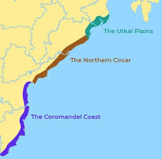
LIES BETWEEN THE EASTERN GHATS AND THE BAY OF BENGAL. STRETCHES FROM WEST BENGAL TO TAMILNADU. WIDER THAN WESTERN COAST. TWO PARTS 1.THE NORTHERN CIRCARS AND 2.THE COROMANDEL COAST
EASTREN COASTAL PLAIN

Slide 14
LIFE IN THE REGION –
FISHING AND FARMING –MAIN OCCUPATION
STATES | CROPS | FOOD | LANGUAGE | FESTIVALS/DANCE | FAMOUS
GUJARAT | JOWAR.BAJRA ,COTTON AND SUGARCANE | FARSANS | GUJARATI | RAS - GARBA | VALLABHAI PATEL STATUE
GOA | CASHEWNUTS AND MANGOES | VINDALOO AND XACUTI | KONKANI | DHALO GOAN | ST XAVIER’S CHURCHAND DUDHSAGAR FALLS
KERALA | RUBBER,TEA.COFFEE AND SPICES | PUTTU | MALYAALAM | KATHAKALI AND MOHINIATTAM | ONAM AND VISHU
TAMILNADU | TEA AND COFFEE | IDLI AND DOSA | TAMIL | BHARATANATYAM | PONGAL
ANDHRA PRADESH | CHILLI | PULIHORA | TELEGU | KUCHIPUDI | KONDAPALLI TOY
ODISHA | COAL IRON ORE ANS MANGANESE | PAKHALA | ODIA | RATHA YATRA/ODISSSI | CHILIKA LAKE

